Slide 1
Unveiling Fundamental Physics from the Cosmic First Light
Dick Bond
CIFAR Fellow and Program Director, Cosmology & Gravity program; University of Toronto, Canadian Institute for Theoretical Astrophysics

Slide 2
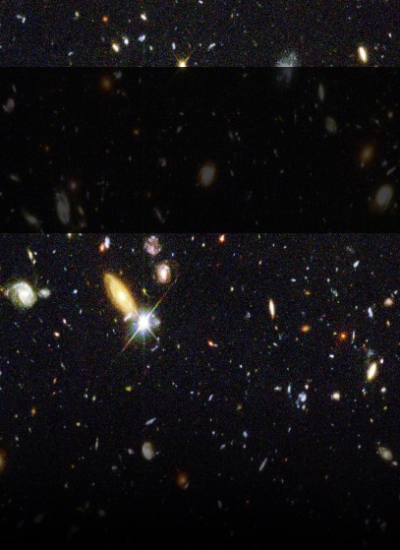
Unveiling Fundamental Physics
from the Cosmic First Light:
from COMPLEXITY to SIMPLICITY
to COMPLEXITY
to SIMPLICITY, the Universe at Large
“To me every hour of the light and dark is a miracle. Every cubic inch of space is a miracle.”
– Walt Whitman
7⁺ numbers
3 densities: ordinary matter 4.4%
dark matter 26.8%
dark energy 68.8%
2 early-Universe inflation structure +1
\
Notes:
Today we have deep and profound Cosmic Questions about the nature of space and time. Are there extra, unseen dimensions of space? Why does time only flow forward? What happens to spacetime in a black hole? What powered inflation? What is the dark energy that permeates space and pushes the universe apart?
There is a miracle in the cubic inch of space under your nose.
In the cubic inch of space under your nose there are 1000 quanta of the radiation of the big bang. There is one million electron volts of dark energy. In that same cubic inch of space is an invisible relic dark matter particle. Finally, every cubic inch of space contains a sea of virtual particles and a new type of potential known as the Higgs potential. Truly, every cubic inch of space is a miracle.
We have a deep understanding of the miracle of space and time, but the nature of dark matter and dark energy are still mysteries. The mysteries of space and time are at the heat of our cosmic questions.

Slide 3
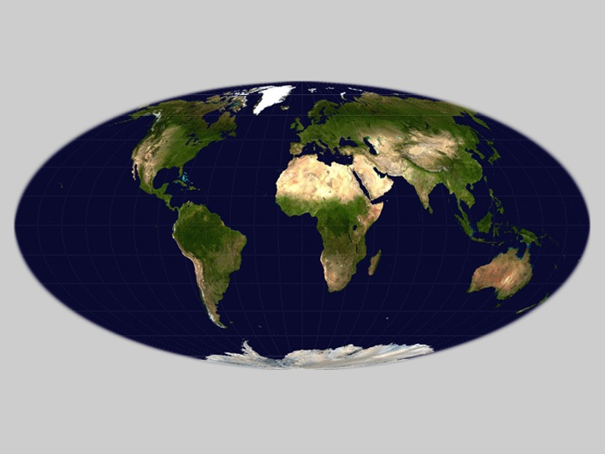
\

Slide 4
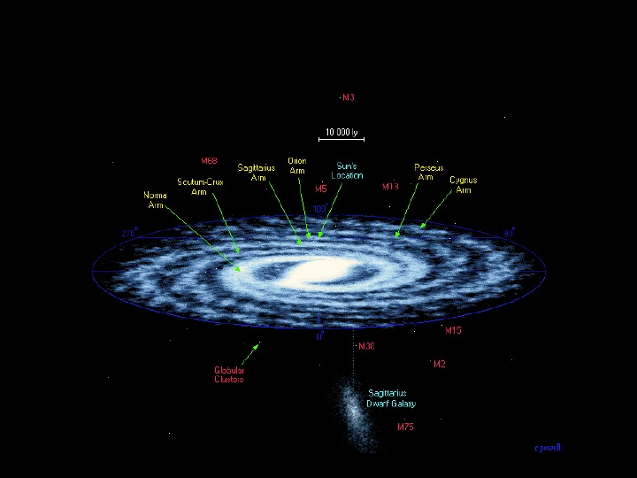
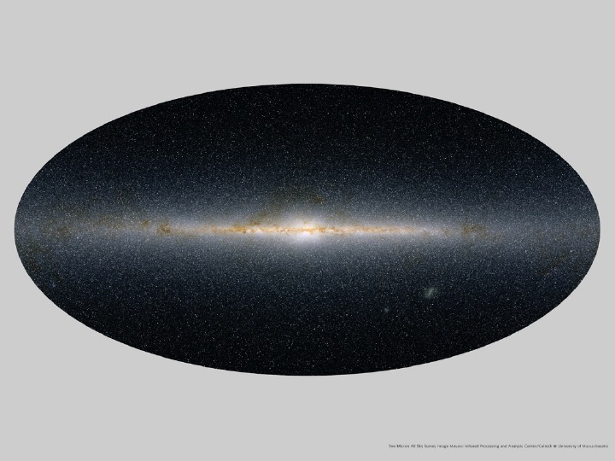
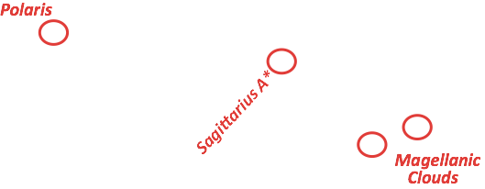
Milky Way in infra-red: half a billion stars, a disk galaxy
in 3D: large dark matter halo

Slide 5
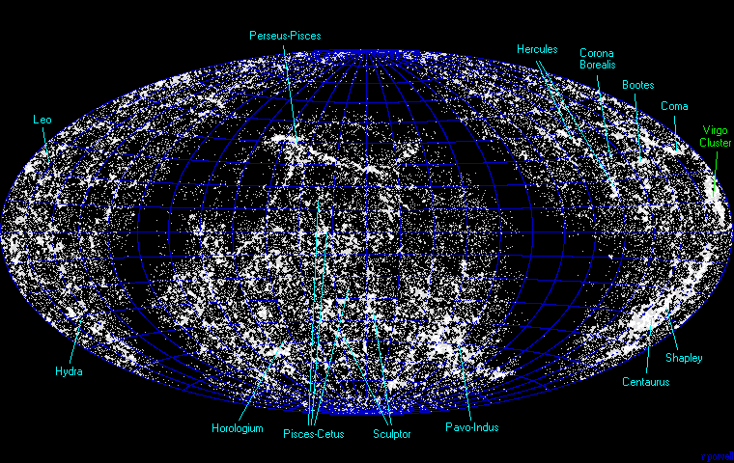
Cosmic Web of 60,000 nearby galaxies: exhibits “local” COMPLEXITY
~1 billion light yrs
cluster
filament
void
supercluster
hard won observational emergence of the cosmic web of galaxies, clustered & interconnected

Slide 6
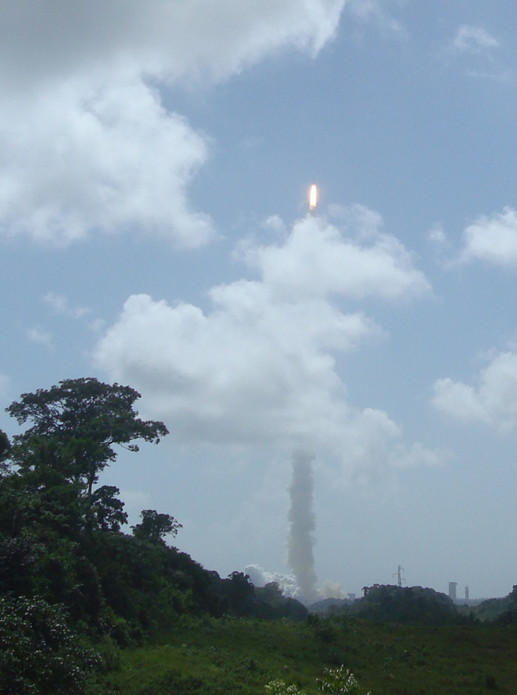
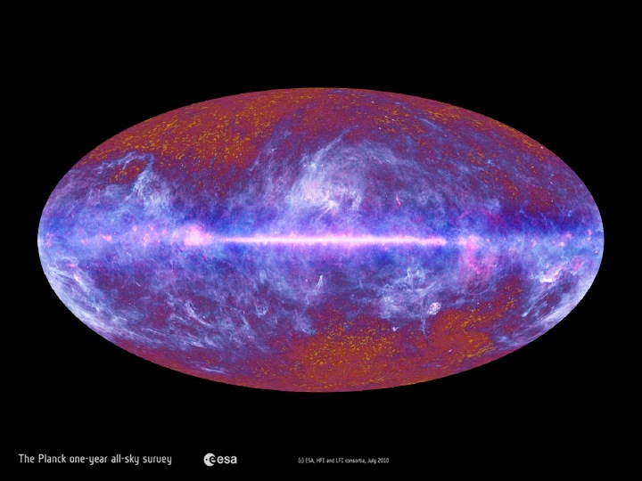
May 14, 2009 French Guiana
COMPLEXITY of here & now
the primordial light, released 13.8 billion years ago, 380,000 yrs after the “Big Bang”
7 veils
Milky Way 2013 in dust grain, radio-wave, carbon monoxide emissions; plus stellar, X-ray, gamma ray, cosmic ray emissions ...

Slide 7
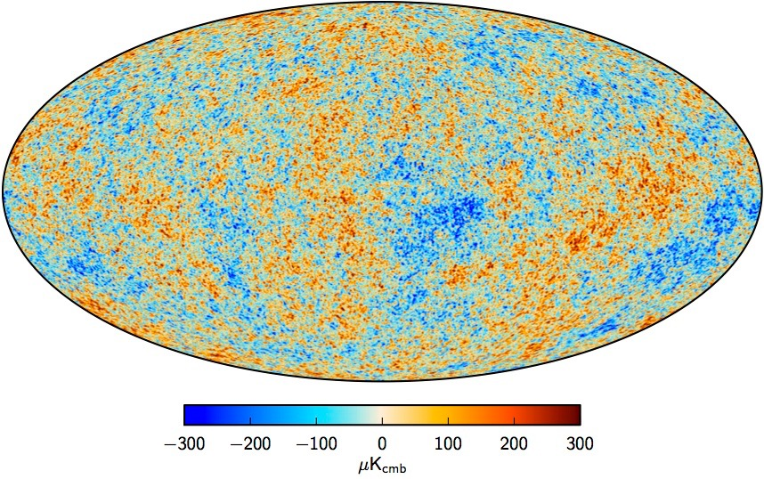
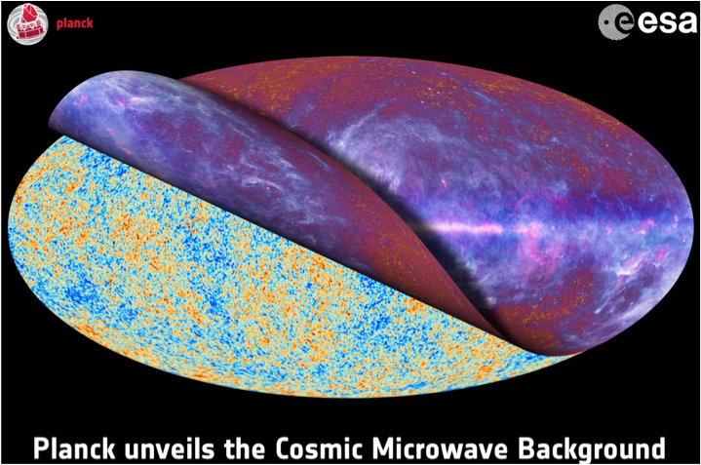
Planck’s primordial light unveiled
reveals primordial sound waves
=> the inharmonious ‘music of the spheres’
in 7⁺ numbers

Slide 8
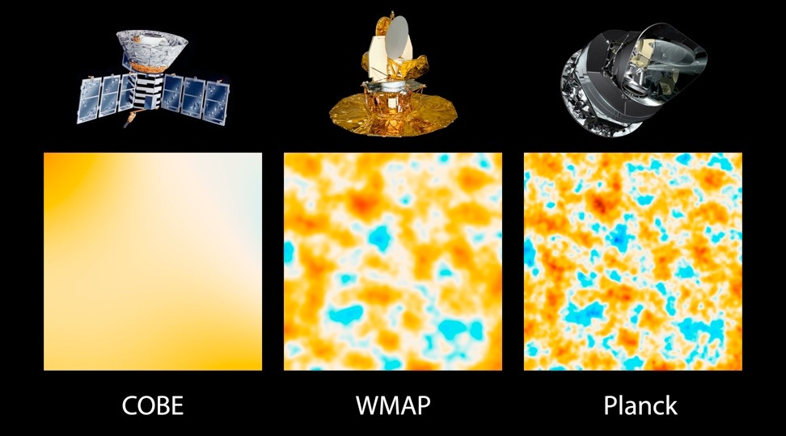
Comparison of CMB Space Experiments: Increasing Resolution
COBE 1989 launch
WMAP 2001 launch
Planck 2009 launch
Temperature changes in micro-degrees
to even higher resolution with telescopes in Chile and the South Pole

Slide 9
Planck’s primordial light unveiled
reveals primordial sound waves
=> the inharmonious ‘music of the spheres’
in 7⁺ numbers
cosmic sound realization

Slide 10
Planck’s primordial light unveiled
reveals primordial sound waves
=> the inharmonious ‘music of the spheres’
in 7⁺ numbers
=> learn matter / energy content & structure at 380000 yr, scale~1/1100
ordinary matter, dark matter, dark energy
in 3 numbers

Slide 11
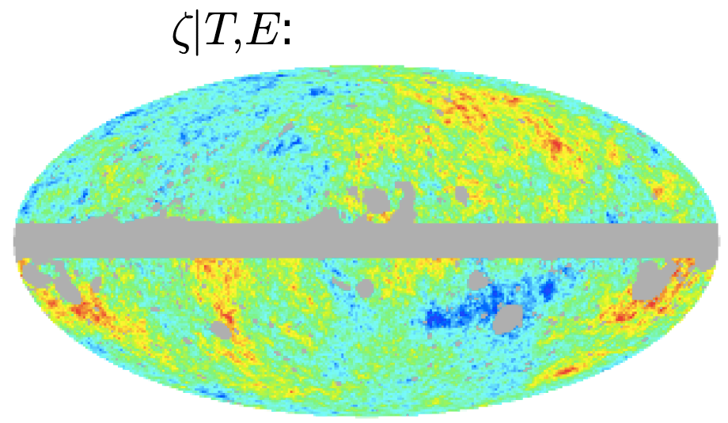
reveals primordial sound from far earlier times
=> the inharmonious early Universe ‘music of the spheres’
=> infer structure far far earlier scale ~ 1/10⁵⁵
in 2 numbers

Slide 12
reveals primordial sound from far earlier times
=> the inharmonious early Universe ‘music of the spheres’
in 2⁺ numbers
the ultra early Universe sounds like classical music (all parts of the audible spectrum are used), with slightly more bass than treble sound is noise-like, as random as can be
Planck’s most celebrated findings

Slide 13
reveals primordial sound from far earlier times
=> the inharmonious early Universe ‘music of the spheres’
=> infer structure far far earlier scale ~ 1/10⁵⁵
in 2 numbers
loudness, treble/bass
we search for a 3rd number, early Universe gravity waves

Slide 14
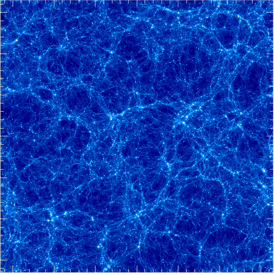
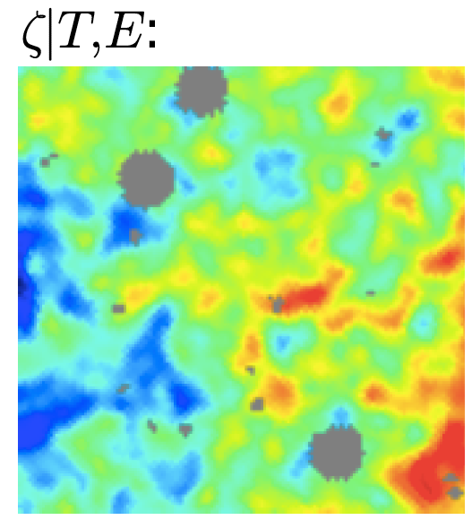
Simulation of the 7⁺ numbers begets the Cosmic Web of clusters now & galaxies forming
SIMPLICITY to COMPLEXITY under Gravity
filament
void
~ billion light years
state of the art simulation
+ ordinary matter + dark matter + dark energy
cluster
supercluster
early Universe simplicity
scale ~1/10⁵⁵10⁻⁵⁵ 10⁻⁵⁵

Slide 15
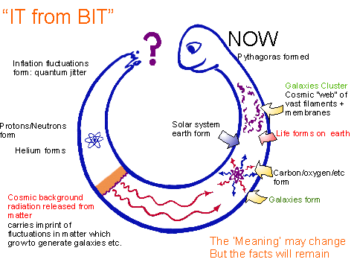
Let there be....
SIMPLE
COMPLEX
CIFAR formed
2 numbers +1
early Dark Energy
~10⁻⁵⁵
writing 1/1.00000017
let there be Heat
scale ~ 10⁻²⁹
COMPLEX
Dark Matter
light nuclei
scale ~1/1.4
Dark Energy inflation
SIMPLE
let there be Light
scale ~ 1/10
scale ~1/1100
7+ numbers
SIMPLE

